Slide 1
Digestion Day 3
Gallbladder-Small Intestines

Slide 2
Composition of Bile
A yellowish-green liquid that is continuously secreted from liver cells
Contains:
Water
Bile salts
Bile pigments (bilirubin and biliverdin)
Cholesterol
Electrolytes
Bile Salts are most abundant and only substance to have a digestive function

Slide 3
Jaundice
Yellowing of skin
Several Causes:
Obstructive Jaundice
Bile ducts are blocked by gallstones or tumors
Hepatocellular jaundice
Live is diseased (cirrhosis or hepatitis)
Hemolytic Jaundice
Red blood cells are destroyed too rapidly (incompatible blood transfusion or blood infection such as Malaria)
Babies
caused by excess bilirubin in the blood. Bilirubin is produced by the normal breakdown of red blood cells.
Normally, bilirubin passes through the liver and is excreted as bile through the intestines. Jaundice occurs when bilirubin builds up faster than a newborn's liver can break it down and pass it from the body. Reasons for this include:
Newborns make more bilirubin than adults do since they have more turnover of red blood cells.
A newborn baby's still-developing liver may not yet be able to remove adequate bilirubin from the blood.
Too large an amount of bilirubin is reabsorbed from the intestines before the baby gets rid of it in the stool.

Slide 4
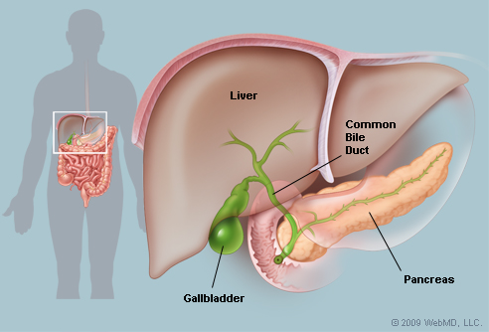
Gallbladder
Pear-shaped sac attached to inferior side of liver
Connects to cystic duct that leads to common hepatic duct
Two join to form bile duct
Hepatopancreatic sphincter prevents bile from entering sm. Intestine to soon.
Stores bile between meals
Reabsorbs water to concentrate bile
Contracts to release bile into small intestine

Slide 5
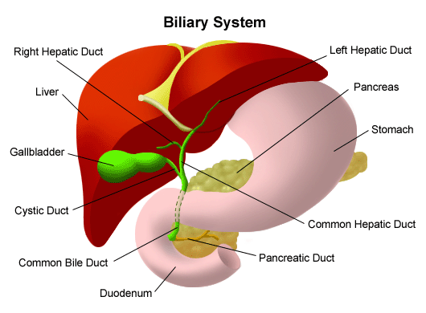
Regulation of Bile Release
Typically Bile doesn’t enter small intestine until hormone cholecytokinin stimulates gallbladder to contract.
Same hormone stimulates stomach to stop production of gastric juice
If gallbladder is missing, bile is continually released into small intestine because the lack of a storage facility.

Slide 6
Function of Bile Salts
Aid digestive enzymes
Works much like soap does on greasy dishes
Helps break fat globules into smaller droplets
Called emulsification
Increases surface area of fatty substance so fat materials can be digested better
Enhance absorption of fatty acids, cholesterol and fat-soluble vitamins A, D, E and K.
Lacking bile salts results in poor lipid absorption and vitamin deficiencies.

Slide 7
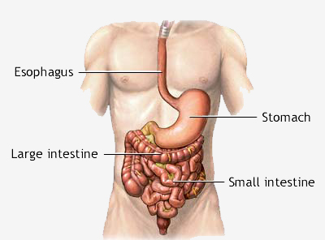
Small Intestines
A tubular organ that extends from the pyloric sphincter to the beginning of the large intestine.
Fills most of abdominal cavity
Receives secretions from pancreas and liver
Completes digestion of nutrients in chyme
Absorbs the products of digestion
Transports the residues to the large intestine

Slide 8
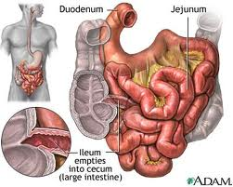
Parts of Sm. Intestine
Three parts:
Duodenum
First 25 cm, 5 cm diameter
Follows a C-shaped path
Most fixed portion
Jejunum
Middle section
Freely mobile
Ileum
Last section, narrowest diameter
Attaches to large intestine by ileocecal sphincter

Slide 9
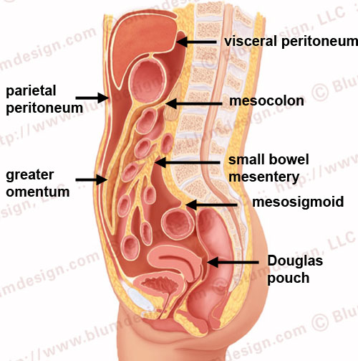
Other Parts of Sm. Intestine
Mesentary
Suspends parts from abdominal wall
Supports the blood vessels, nerve and lymphatic vessels
Greater Omentum
Drape like apron from the stomach over the transverse colon and folds of small intestine
Walls off an area of infection preventing infected cells from spreading throughout abdo. Cavity.

Slide 10
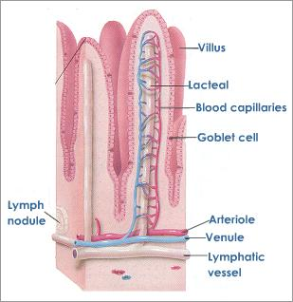
Structure of the Wall
Appears velvety due to many tiny projections call intestinal villi
Most numerous in the duodenum and proximal jejunum
Greatly increase the surface area of intestinal lining, aiding the absorption of digestive products.
Lacteal
Center of villi made up of blood vessels and lymphatic tissue
Carries away absorbed nutrients
Intestinal Gland
Between base of adjacent villi

Slide 11
Secretions of Sm. Intestine
Mucosa secretes mucus throughout tube
Enzymes Secreted:
Peptidases
Split peptides into amino acids
Sucrase, Maltase, Lactase
Split sugars
Intestinal Lipase
Split fats
Regulation
Nerve impulses trigger release of enzymes

Slide 12
Absorption
Villi increase surface area
Carb digestion starts in mouth and is completed in small intestine
Protein digestion starts in stomach and is completed in small intestine
Fat molecules are digested almost entirely by enzymes in small intestine
Absorbs electrolyte by diffusion and active transport and water by osmosis

Slide 13
Movements of Sm. Intestine
Mixing and peristalsis
Segmentation
Periodic small-ringlike contractions cut chyme into segments and move it back and forth, slows movement of chyme through tube.
Chyme takes 3-10 hours to travel the length of sm. Intestine
Peristaltic Rush
If wall becomes overdistended or irritated, movement sweeps the contents of small intestine into large intestine
Happens so quickly that nutrients aren’t properly absorbed
Diarrhea occurs

